Slide 1
Presented by Group 1
Course: SOT375 - 64.CNTT-3
Instructed by: MSc. Ha Thi Thanh Nga
BLOCKCHAIN
Revolutionizing Transactions and Interactions in the Digital Age

Slide 2
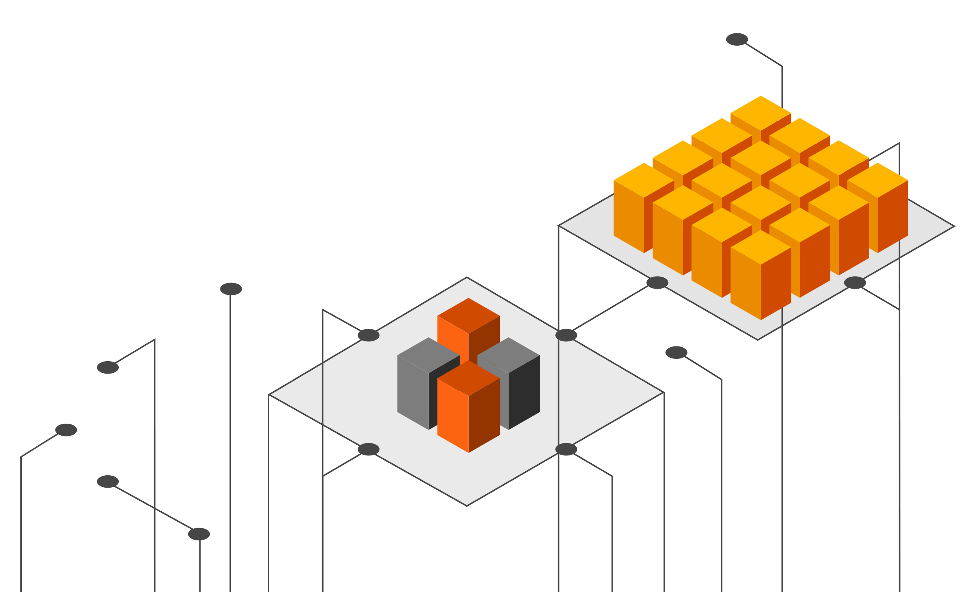
01
Introduction

Slide 3
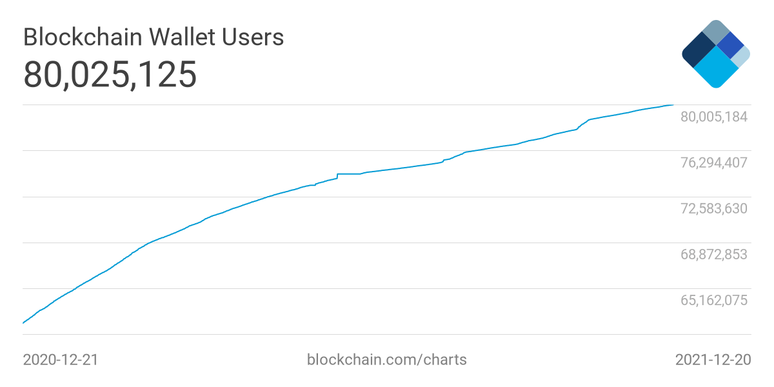
What is Blockchain
Blockchain is a distributed and decentralized digital ledger that records transactions across multiple computers. Its design prevents altering previous transactions, ensuring transparency and security.
Fact: 2.8% of the world's population is already using blockchain.

Slide 4
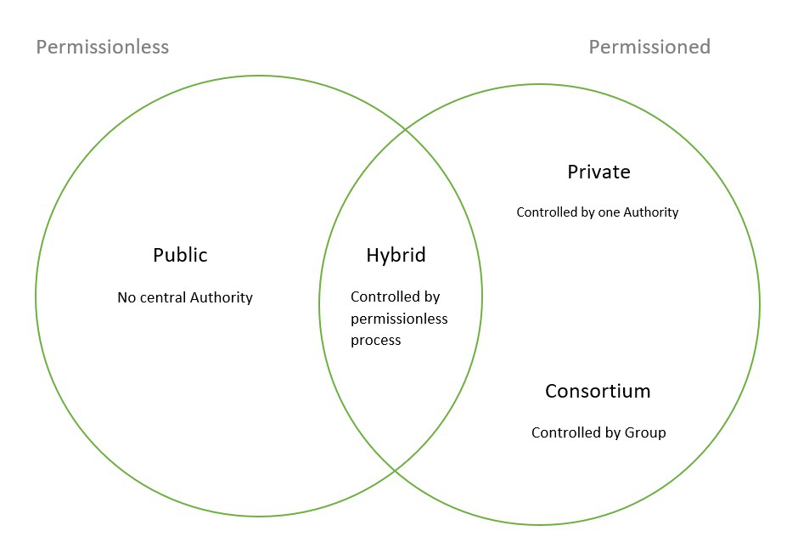
Main types of Blockchain
1
Public Blockchains
2
Private Blockchains
3
Consortium blockchains

Slide 5
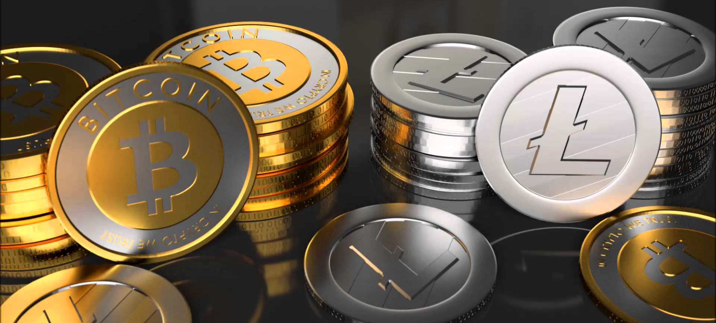
Cryptocurrencies

Slide 6
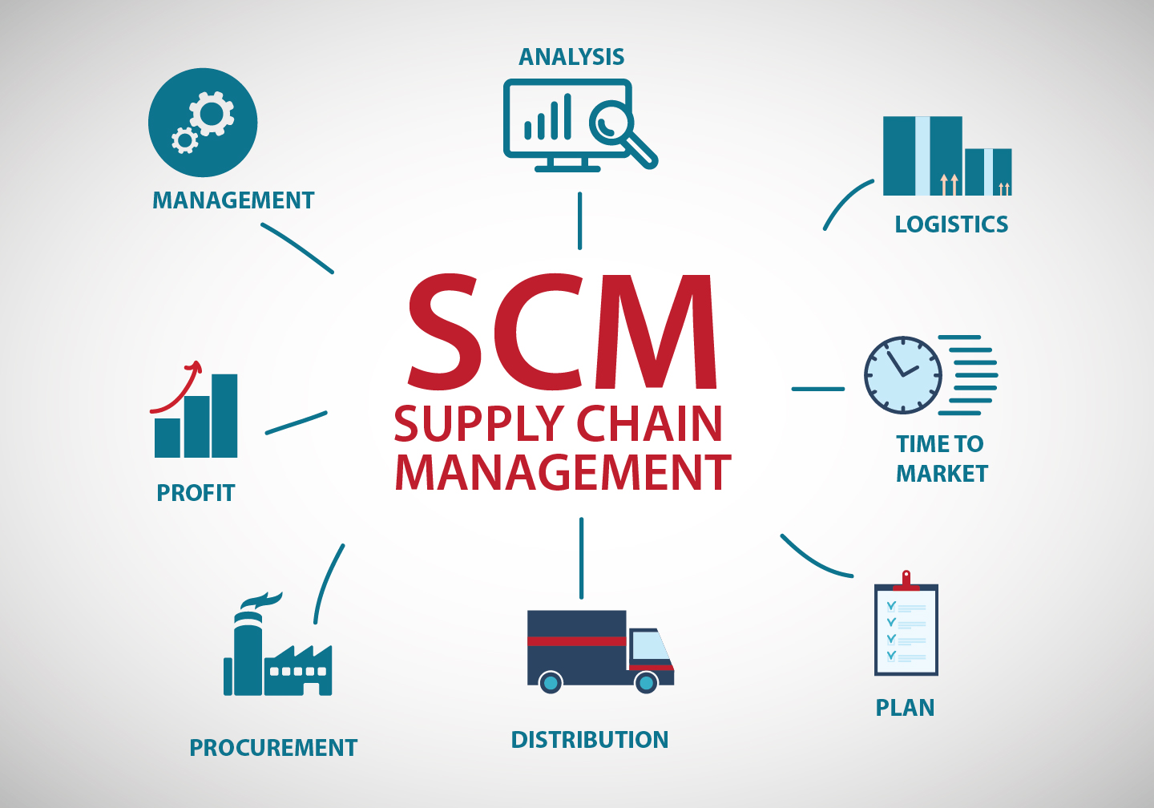
Supply Chain Management

Slide 7
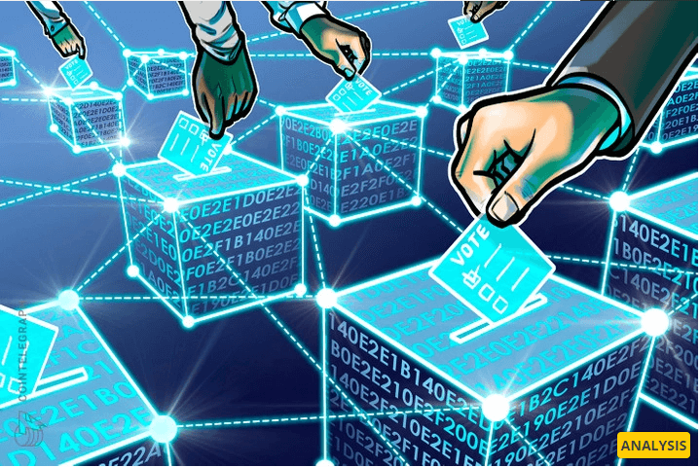
Voting Systems

Slide 8
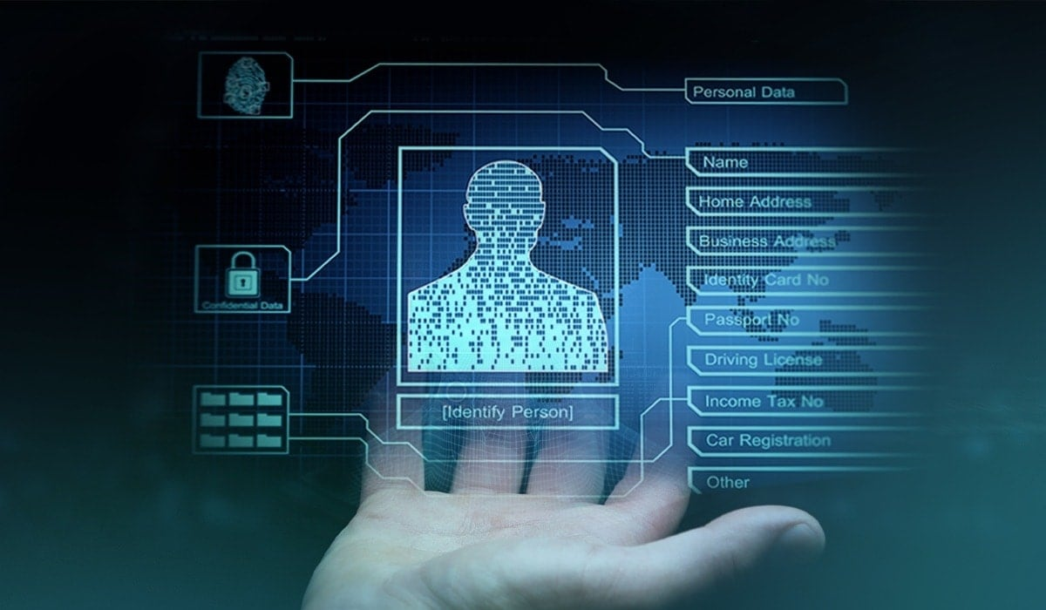
Digital Identity Management

Slide 9
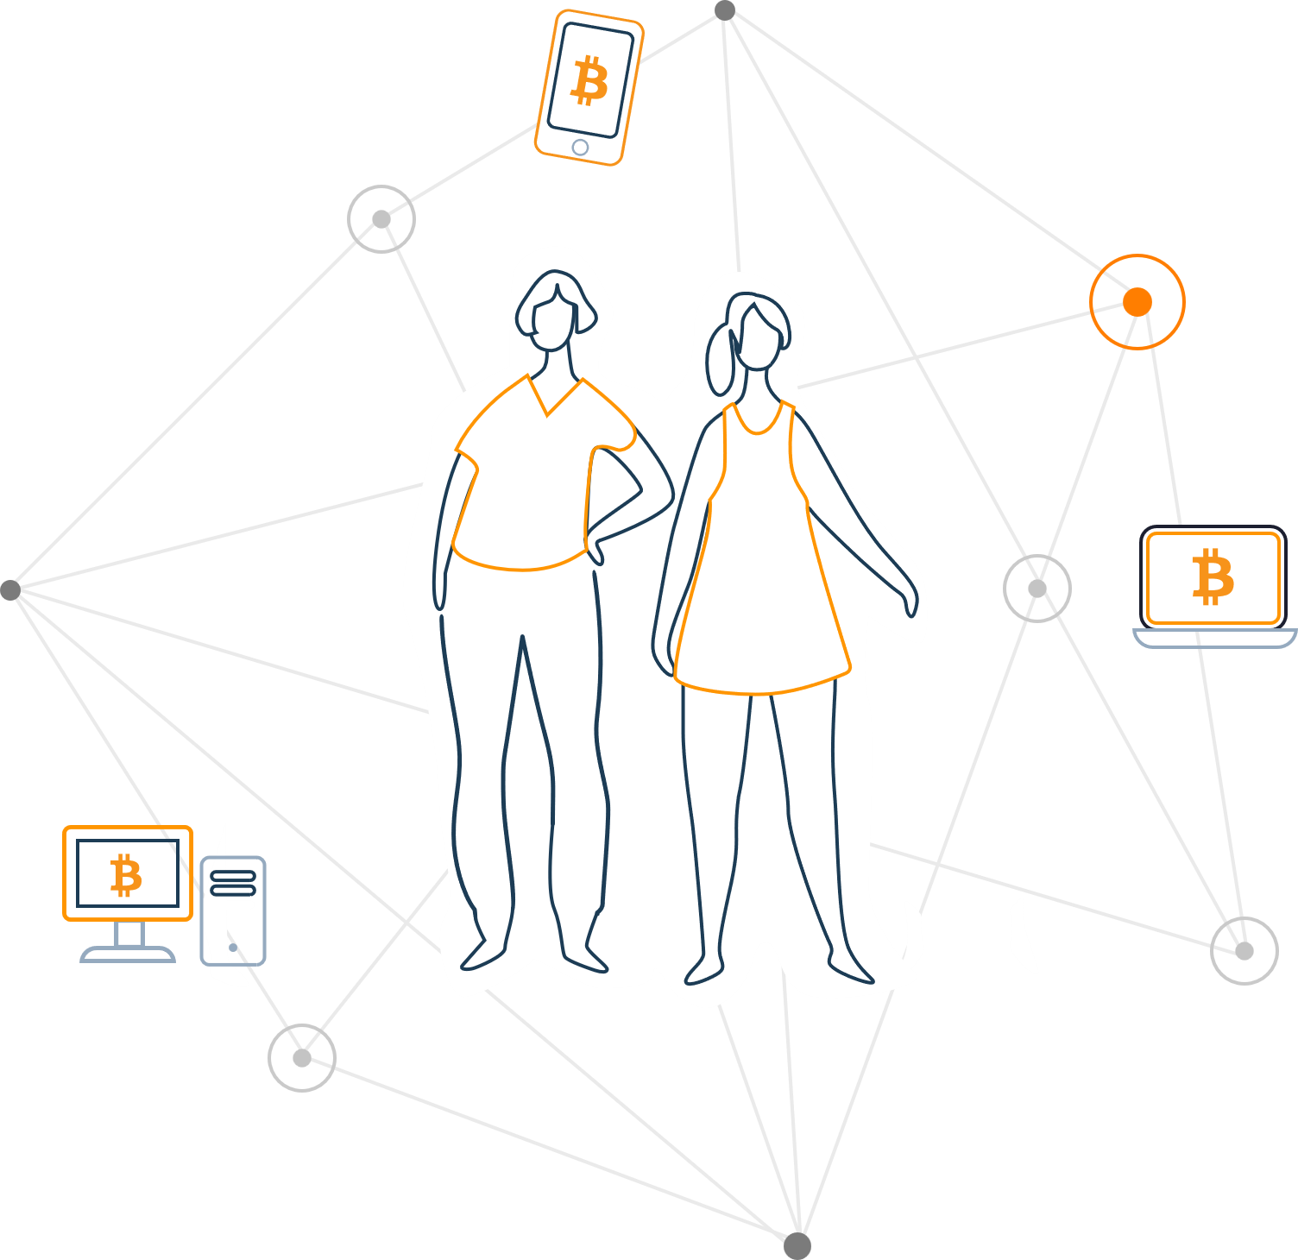
02
Working mechanism of Blockchain

Slide 10
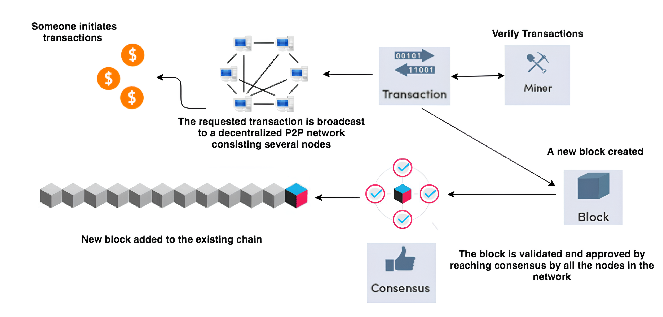
Components in Blockchain

Slide 11
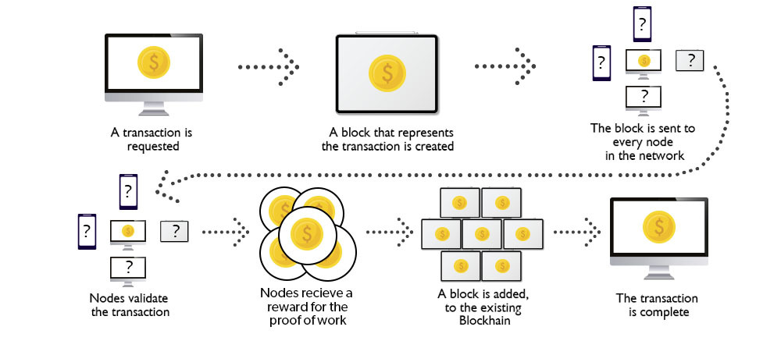
How Blockchain works?

Slide 12
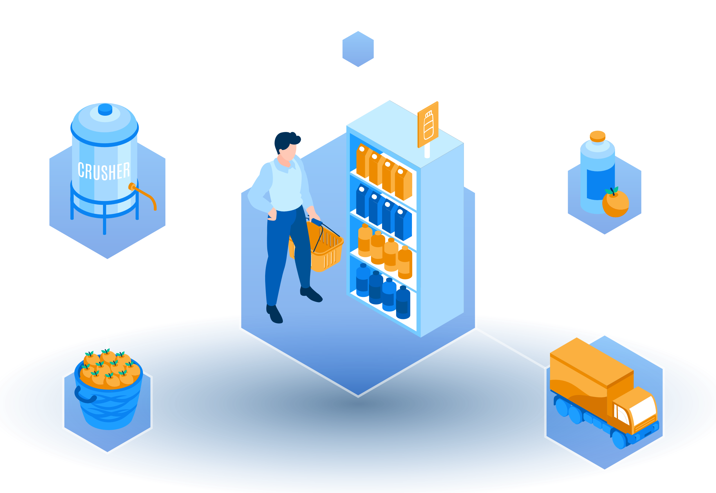
03
Challenges and issues of Blockchain

Slide 13
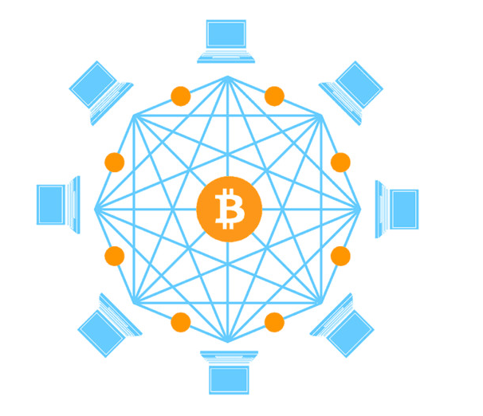
The 5 biggest problems with Blockchain technology
Scalability
Security
Privacy
Interoperability
Energy consumption

Slide 14
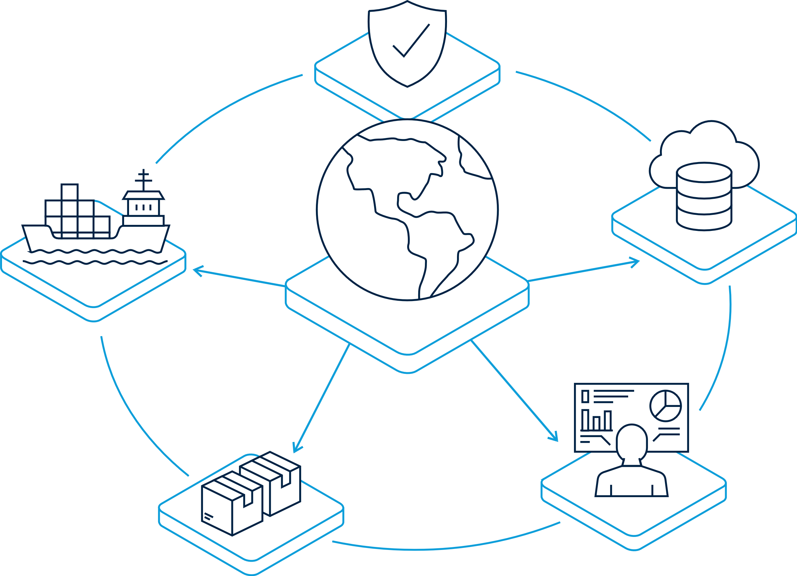
04
Future of
Blockchain

Slide 15
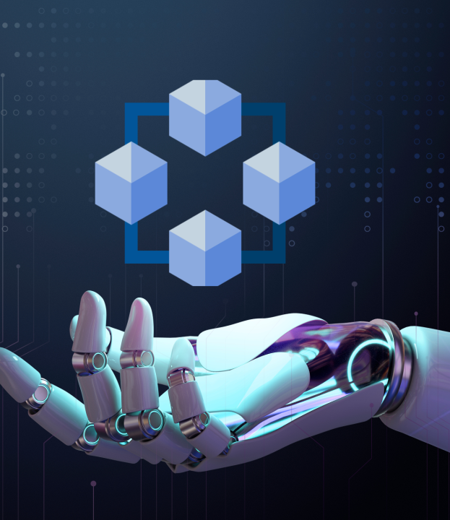
Overview
AI is changing data interaction, and combined with blockchain, it enables deploying AI models on decentralized platforms, ensuring privacy and security. Blockchain transparency aids in monitoring and addressing AI decision reliability.

Slide 16
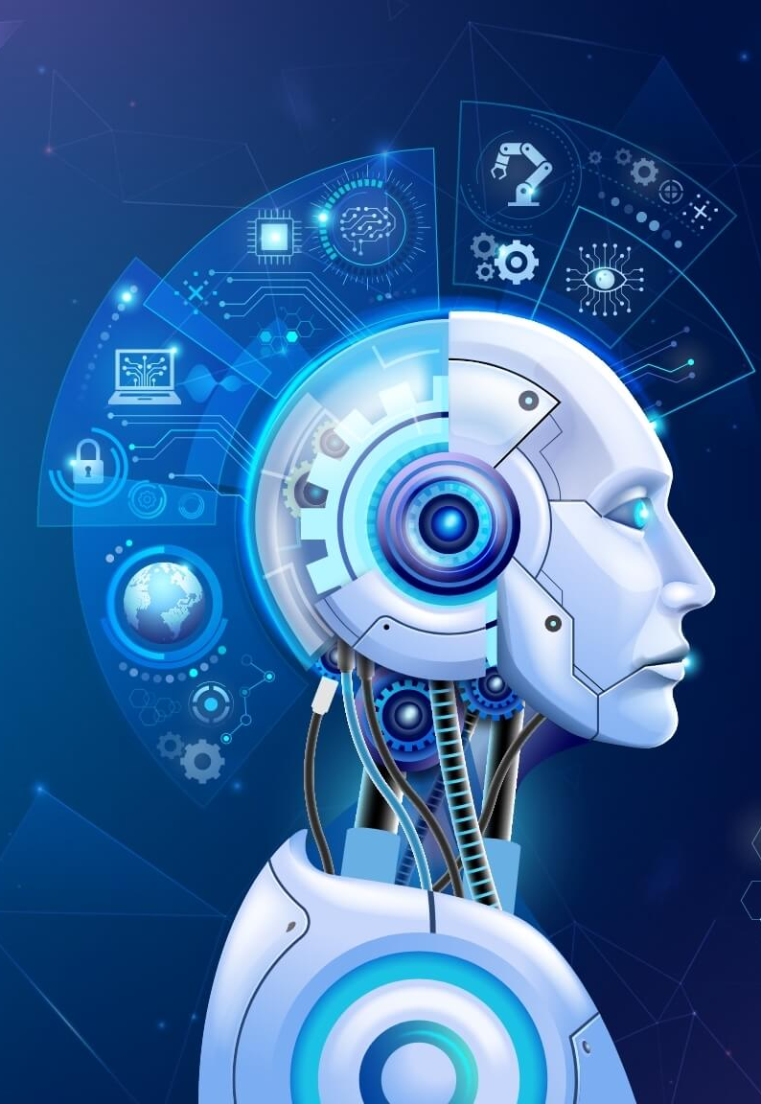
Overview
AI plays a crucial role in enhancing blockchain applications, from simplifying tasks like creating landing pages for crypto companies to enabling faster and cheaper transactions in decentralized protocols.

Slide 17
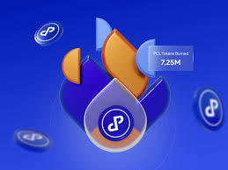
The world of finance
Leveraging AI to provide accurate predictions in cryptocurrency markets, making these volatile markets more accessible to investors.

Slide 18
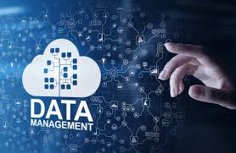

Data management and privacy
Uses blockchain to provide a secure, decentralized data marketplace, could harness AI to analyze and classify the massive amounts of data exchanged, thereby improving data accessibility and use.

Slide 19

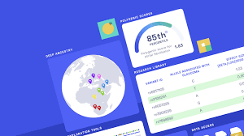
Healthcare
Provide secure, immutable patient records
Analyze those records to predict disease patterns, improve diagnoses, and personalize treatment plans
Uses blockchain to store genomic data securely and AI to analyze that data for personalized health insights.

Slide 20
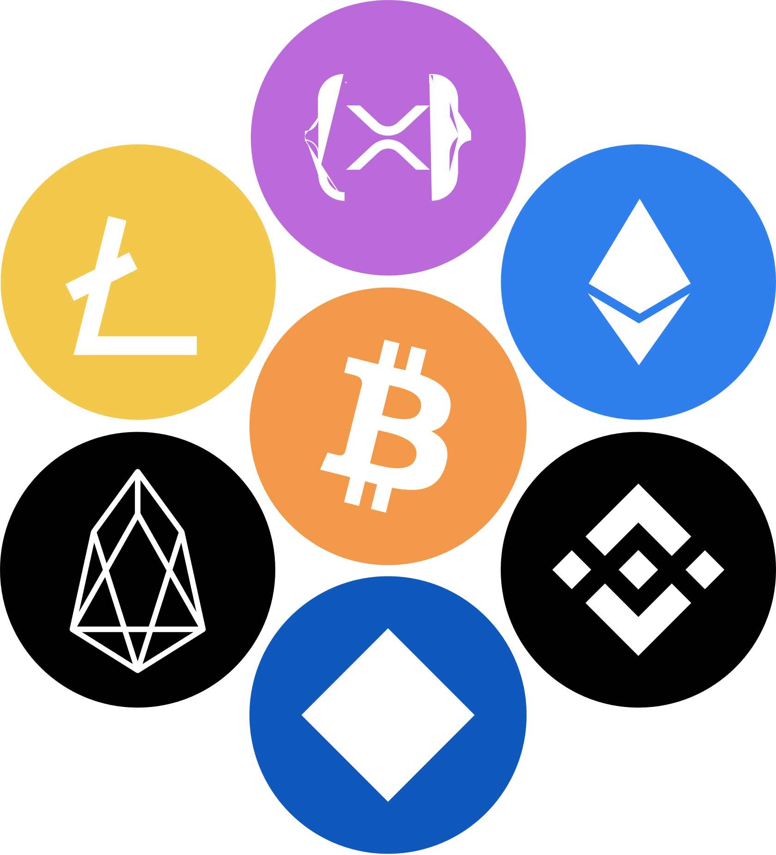
05
Significant Blockchain projects and platforms

Slide 21
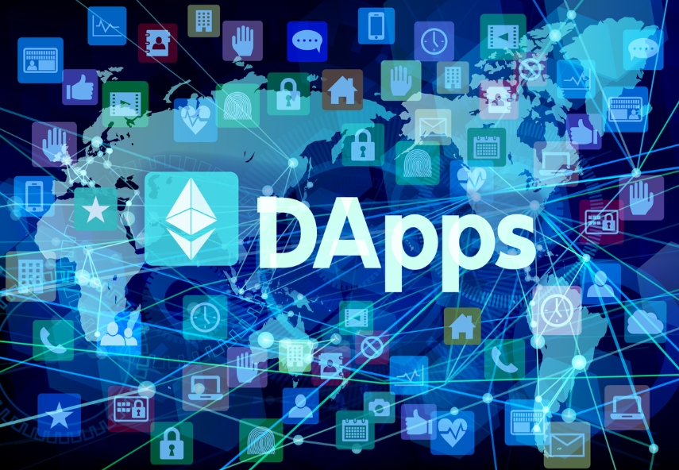
Ethereum
Create decentralized applications (DApps)
Conduct transactions without intermediaries.
Developments in decentralized finance (DeFi) and Non-fungible tokens (NFTs).

Slide 22
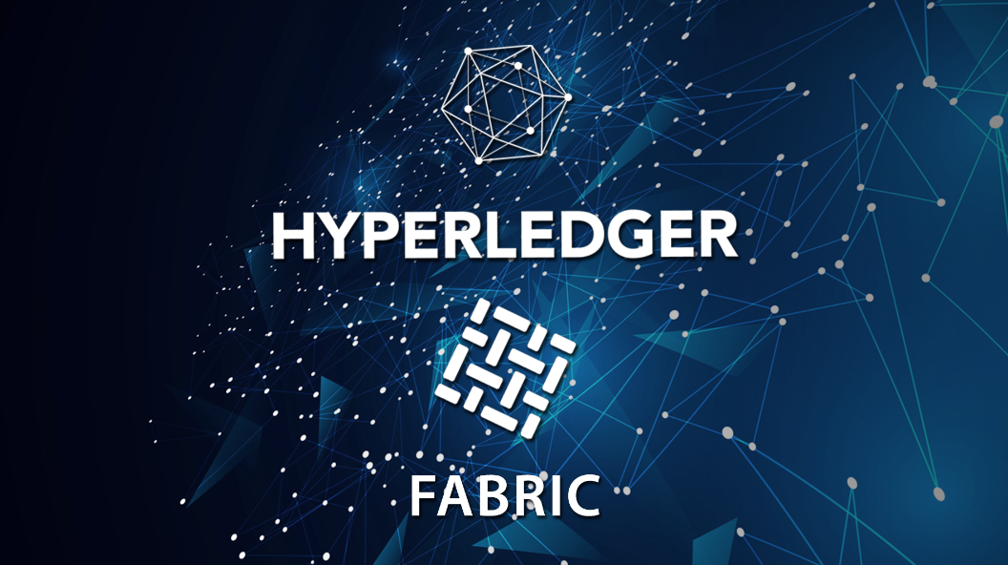
Hyperledger
Create secure and scalable blockchain solutions for businesses.

Slide 23

Ripple
Using its digital asset XRP.
Make international transactions faster and cheaper.

Slide 24

06
Skills and knowledge for Blockchain

Slide 25
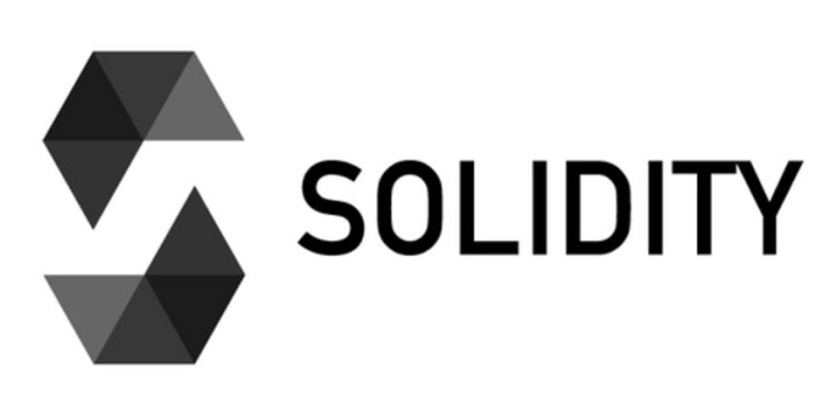
Computer Programming
Master key languages: Solidity for Ethereum development and Python for general coding.
pragma solidity >=0.4.0 <0.8.0;
contract SimpleContract {
string name;
function set(string newName) public {
name = newName;
}
function get() public view returns (string) {
return name;
}
}

Slide 26

Smart Contracts
Develop smart contracts in Solidity, enabling automatic, condition-based transaction execution.

Slide 27

Cybersecurity and Cryptography
Secure blockchain with cryptography and distributed systems for enhanced data protection.

Slide 28
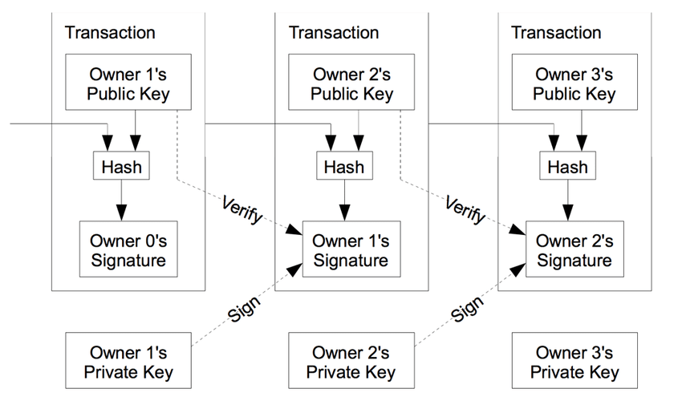
Data Structures
Understand hashes to ensure data integrity and immutability within blockchain networks.

Slide 29
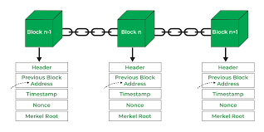
Blockchain Architecture
Grasp the fundamentals of blockchain architecture including consensus mechanisms like PoW and PoS

Slide 30
Thank you!
Do you have any question?

